Slide 1


AWS Systems Manager
Unified Configuration and Secrets Management: A Deep Dive into Parameter Store Capabilities
Cloud Infrastructure Excellence Series

Slide 2
Core Fundamentals
Understanding the foundation of centralized configuration management in AWS

Slide 3


SERVICE OVERVIEW
AWS Systems Manager Parameter Store provides secure, hierarchical storage for configuration data management and secrets management.
You can store data such as passwords, database strings, Amazon Machine Image (AMI) IDs, and license codes as parameter values.
It allows you to separate your environmental configuration from your application code, improving security and operational efficiency.

Slide 4






KEY CAPABILITIES
Hierarchical
Versioning
IAM Control
Policies
Organize parameters using paths (e.g., /prod/db/url) for logical grouping.
Automatic history tracking; reference specific versions for rollback.
Granular access control using AWS Identity and Access Management.
Set expiration dates and notifications for parameter maintenance.

Slide 5
Security & Scalability
Architecture designed for enterprise-grade protection and high-throughput environments

Slide 6
PERFORMANCE METRICS
High Throughput Mode
10k
By default, Parameter Store supports 40 transactions per second (TPS). Advanced users can enable high throughput to reach 10,000 TPS, supporting massive serverless or containerized workloads.
REQUESTS/SEC

Slide 7

SECURITY FIRST DESIGN
SecureString: Store sensitive data encrypted with AWS KMS.
Auditability: All actions are logged in AWS CloudTrail for compliance.
Decryption Control: Restrict decryption permissions via KMS Key Policies.
Cross-Service: Native integration with Lambda, EC2, and CloudFormation.

Slide 8
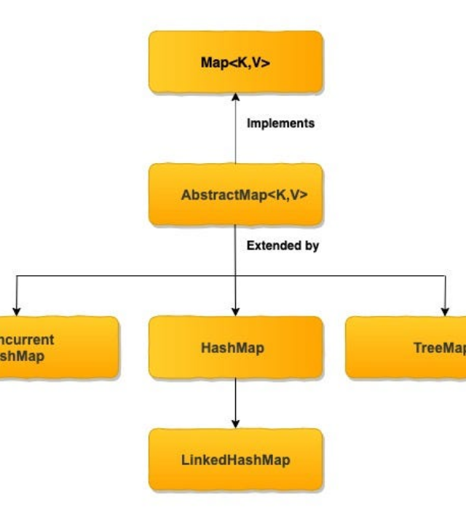

LOGICAL PATH HIERARCHIES
Organization is key to managing thousands of configurations. Use paths to define environments, regions, and application names.
Paths enable easy recursive fetching of all parameters for a specific application component.

Slide 9
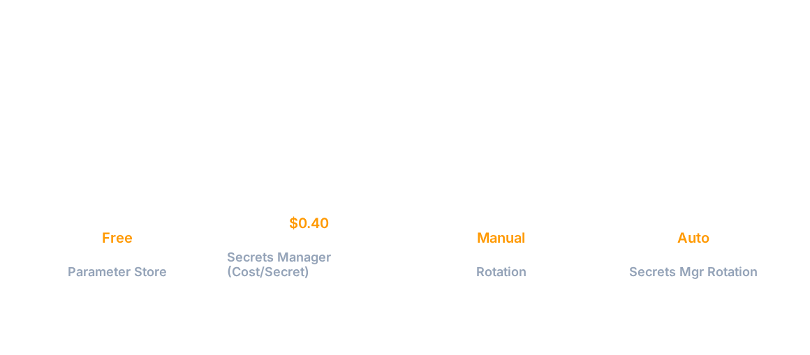
PARAMETER STORE VS SECRETS MANAGER
Use Parameter Store for configuration and static secrets. Use Secrets Manager for secrets requiring automatic rotation (RDS, etc.).

Slide 10
DEPLOYMENT WORKFLOW
Define
Store
Fetch
Monitor
Identify configuration keys and tier requirements.
Upload via CLI, SDK, or CloudFormation.
App retrieves value at runtime securely.
Track usage and history in CloudTrail.

